Slide 1

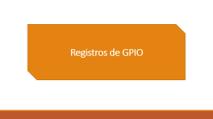
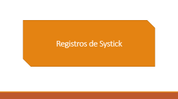
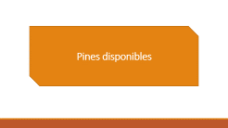

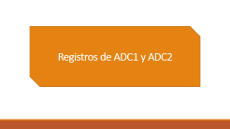
Selección de datasheet STM32F103C8
Registros e información para programar

Slide 2
Registros de GPIO

Slide 3
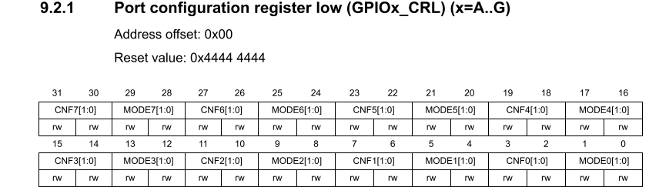
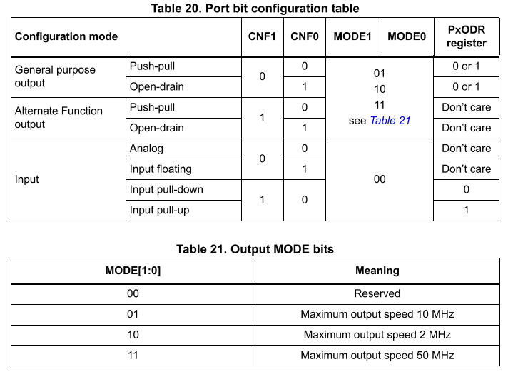
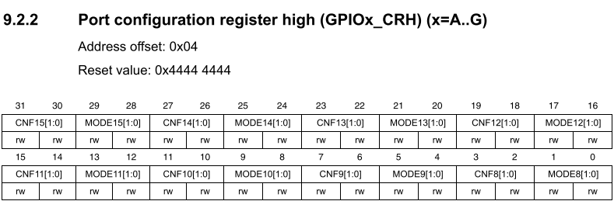
Configuracion de puertos/pines

Slide 4
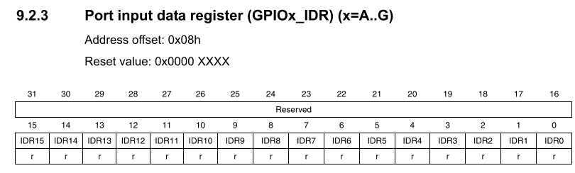
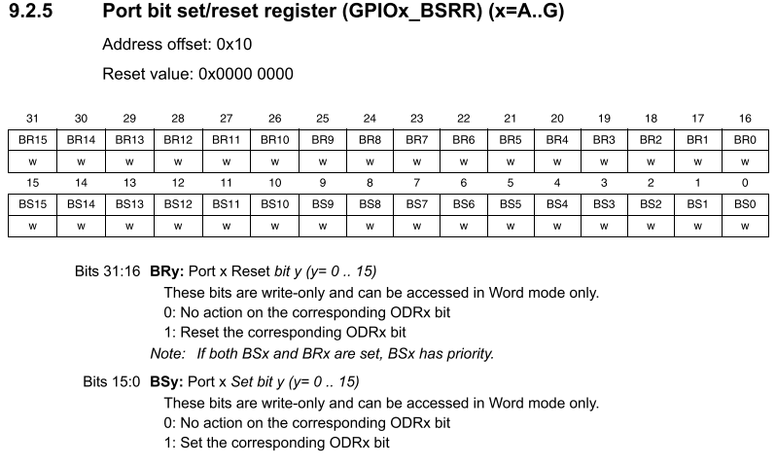
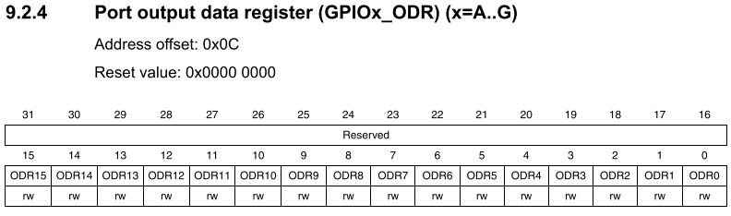
Lectura/escritura de pines
Input Data Reg
Atomic set/reset
Evita tener que deshabilitar interrpuciones para el cambio de output
Output Data Reg

Slide 5
Registros de Clock y PLL

Slide 6
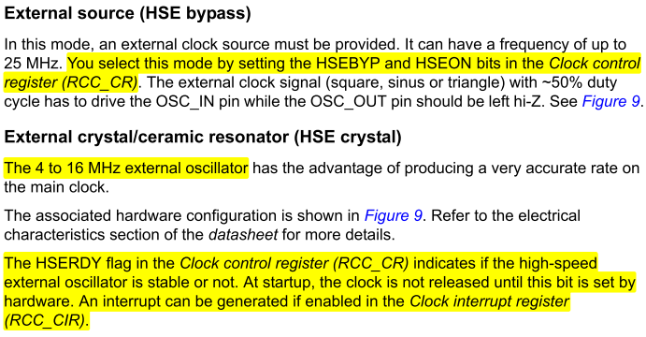
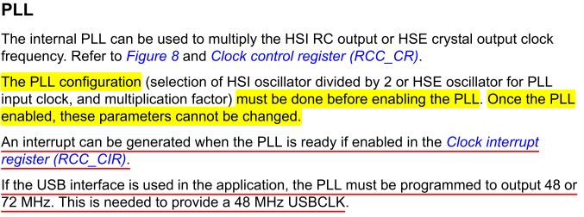
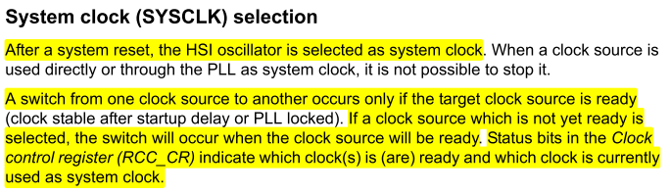
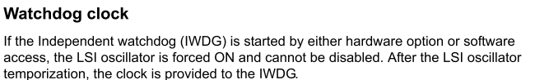
Sobre el HSE, PLL, etc

Slide 7
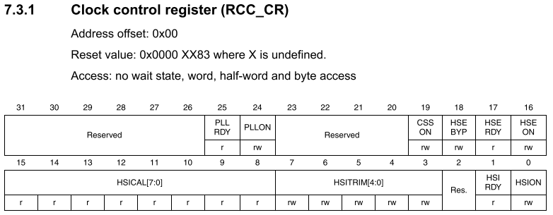
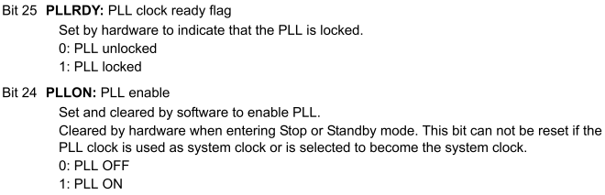
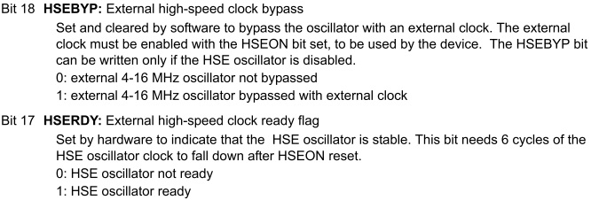
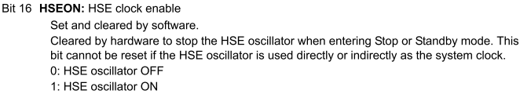
Registros de RCC
Configurar HSE y PLL

Slide 8
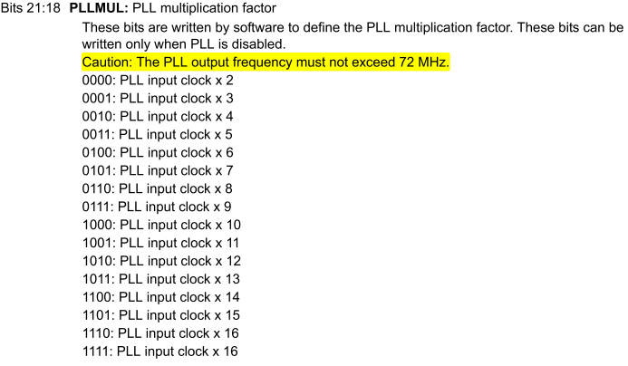
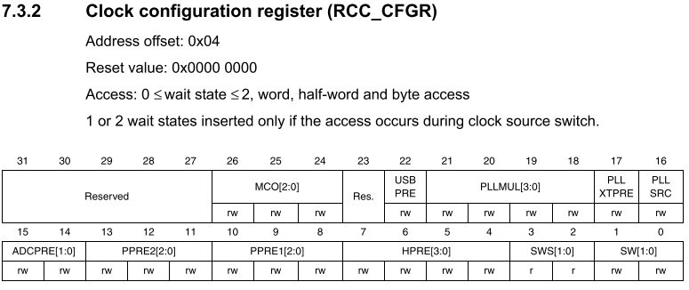
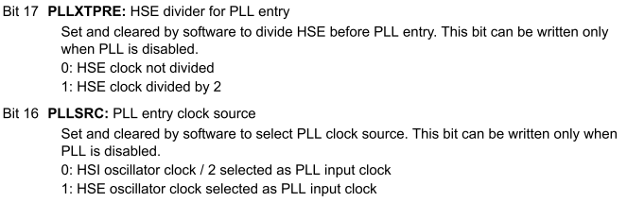
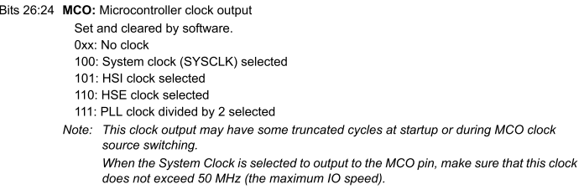
Registros de RCC
PLL y seleccion de SysClock
CLOCK CONFIGURATION
Continua

Slide 9
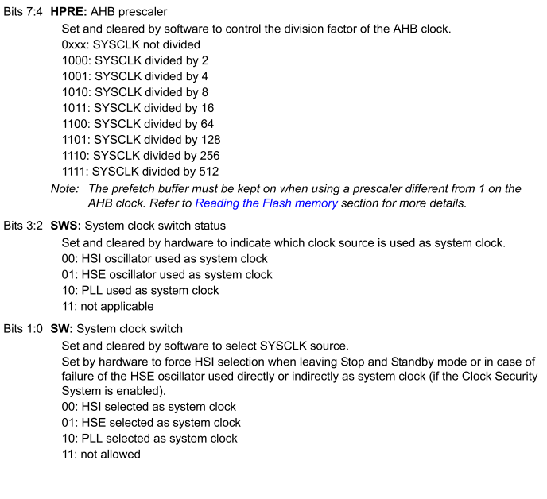
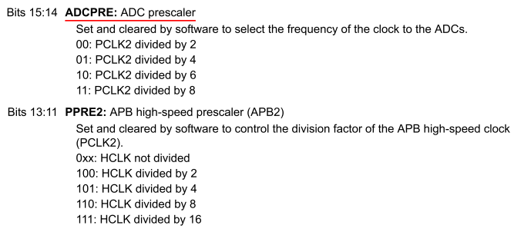
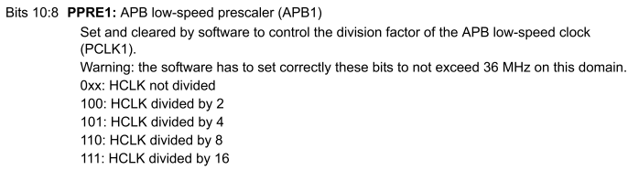
Registros de RCC
PLL y seleccion de SysClock

Slide 10
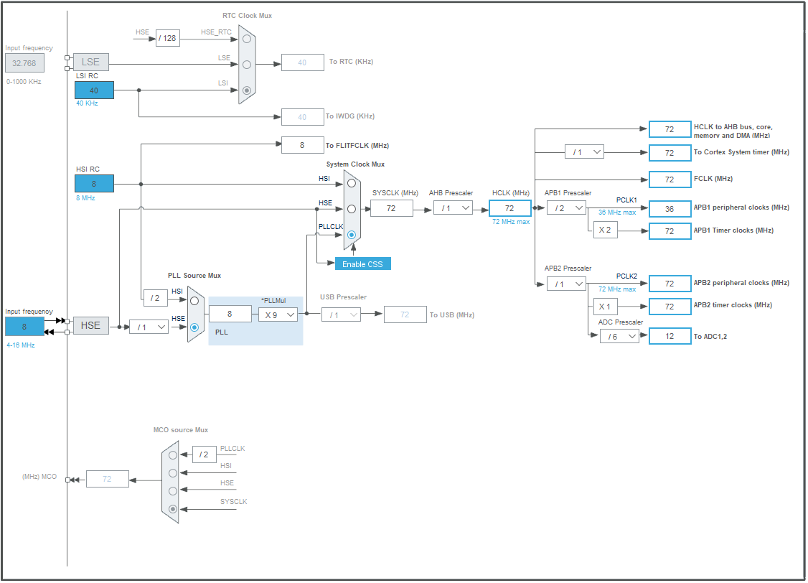
PLL y Clock
DIAGRAMA DE CONFIGURACIÓN

Slide 11
Registros de Systick

Slide 12
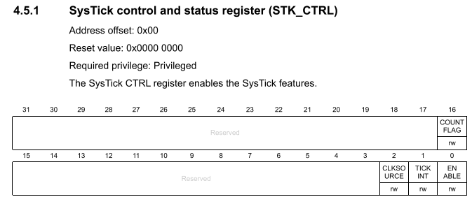
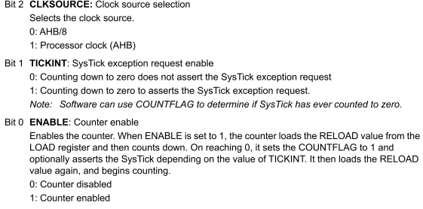
Registros de RCC
Configurar HSE y PLL
void Systick_init(void){
//tick cada 2.5ms
SYSTICK->STRELOAD = SYSTICK->STCALIB/4 -1;
//clock interno
SYSTICK->STCTRL.ClkSource = 1;
SYSTICK->STCURR = 0;
SYSTICK->STCTRL.TickInt = 1;
SYSTICK->STCTRL.Enable = 1;
}
The base address of the SysTick register block is 0xE000 E010.
→De Info II

Slide 13
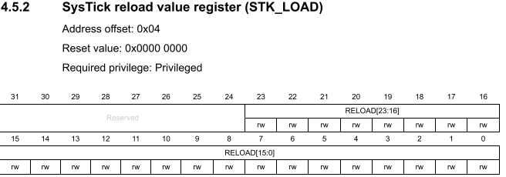
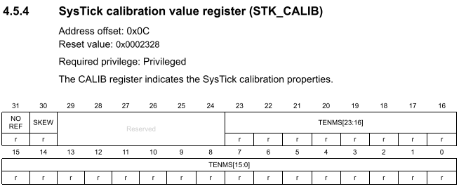
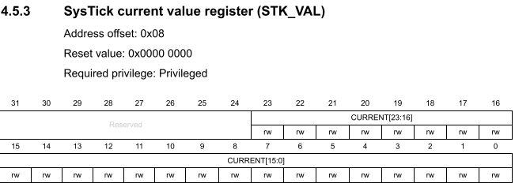
Registros de RCC
PLL y seleccion de SysClock
The CALIB register is for 1ms ticks at 9MHz (Max processor frequency / 8 )

Slide 14
Registros de DMA Direct Acces Memory

Slide 15
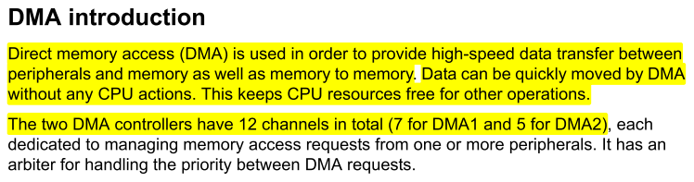
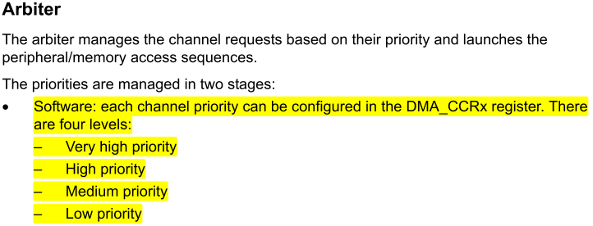
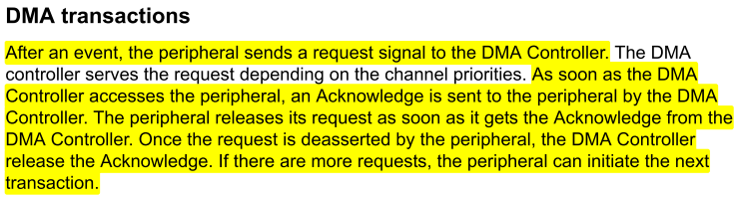
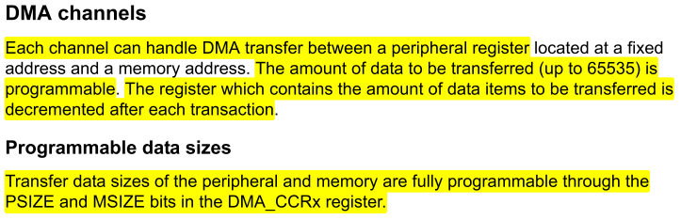
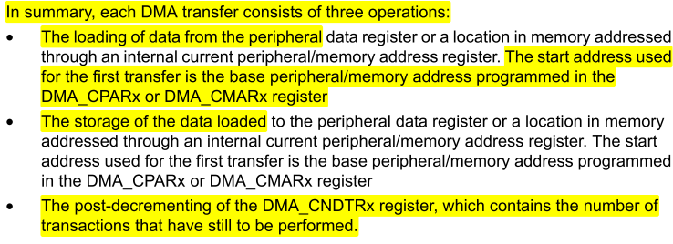
Registros de DMA
Introduccion y modos

Slide 16
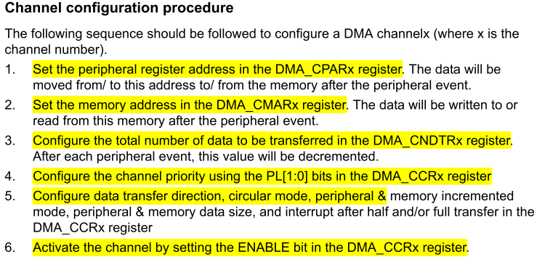
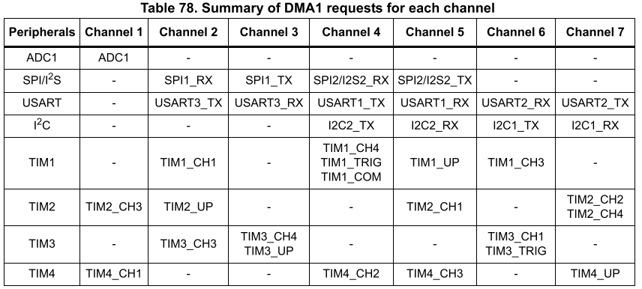
Registros de DMA
Introduccion y modos

Slide 17
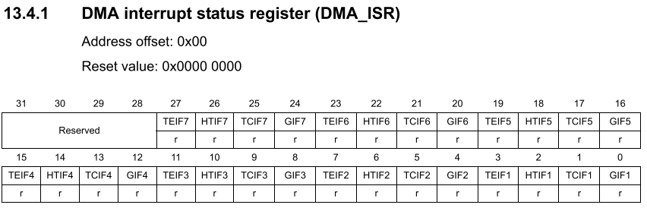
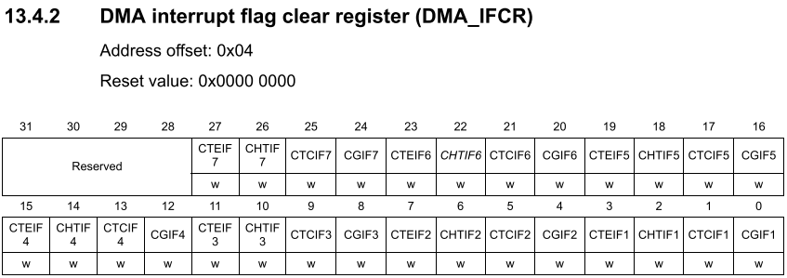
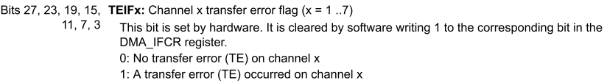
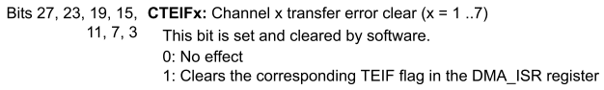
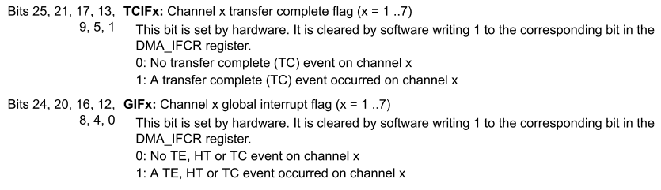
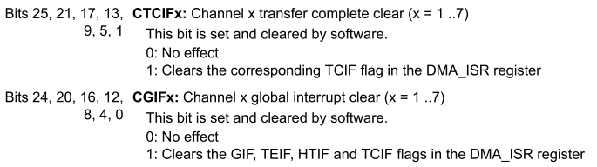
Registros de DMA
Interrupciones

Slide 18
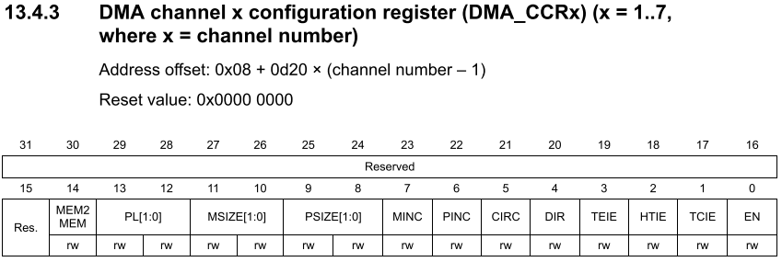
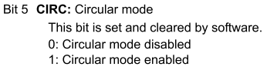
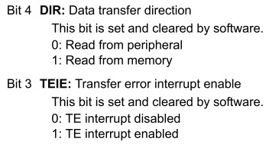
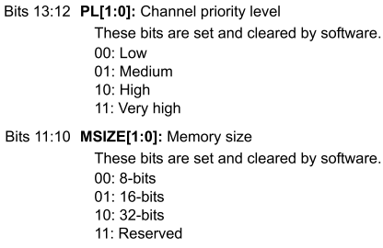
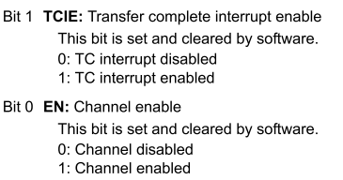
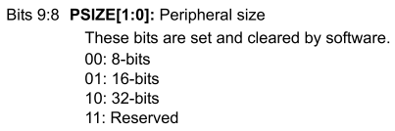
Registros de DMA
Configuración

Slide 19



Registros de DMA
Data & peripherial register

Slide 20
Registros de ADC1 y ADC2

Slide 21





Registros de ADC
Introducción y modos

Slide 22





Registros de ADC
Introducción y modos
USA DMA
USA DMA

Slide 23







Registros de ADC
Status y configuración

Slide 24







Registros de ADC
Status y configuración

Slide 25




Registros de ADC
Sample time

Slide 26






Registros de ADC
Orden

Slide 27

Registros de ADC
Lecturaº

Slide 28
Pines disponibles

Slide 29
Pines y su uso
Funciones alternativas
PUERTO | PIN | ALT FUNC | USO
PORT A | 0 | WKUP, USART2_cts, ADC_in0, TIM2_ch1_etr
PORT A | 1 | USART2_rts, ADC_in1, TIM2_ch2
PORT A | 2 | USART2_TX, ADC_in2, TIM2_ch3
PORT A | 3 | USART2_RX, ADC_in3, TIM2_ch4
PORT A | 4 | SPI1_nss, USART2_ck, ADC_in4
PORT A | 5 | SPI1_SCK, ADC_in5
PORT A | 6 | SPI1_MISO, ADC_in6, TIM3_ch1
PORT A | 7 | SPI1_MOSI, ADC_in7, TIM3_ch2
PORT A | 8 | USART1_ck, TIM1_ch1, MCO
PORT A | 9 | USART1_TX, TIM1_ch2
PORT A | 10 | USART1_RX, TIM1_ch3
PORT A | 11 | USART1_cts, CAN_RX, USB_DM , TIM1_ch4
PORT A | 12 | USART1_rts, CAN_TX, USB_DP , TIM1_ETR
PORT A | 13 | (JTMS, SWDIO are primary & only func)
PORT A | 14 | (JTCK, SWCLK are primary & only func)
PORT A | 15 | (JTDI are primary & only func)
PUERTO | PIN | ALT FUNC | USO
PORT B | 0 | ADC_in8, TIM3_ch3
PORT B | 1 | ADC_in9, TIM3_ch4
PORT B | 2 | (PORTB 2, BOOT1 are primary & only func)
PORT B | 3 | (JTDO are primary & only func)
PORT B | 4 | (JNTRST are primary & only func)
PORT B | 5 | I2C1_SMBAI
PORT B | 6 | I2C1_SCL, TIM4_ch1
PORT B | 7 | I2C1_SDA, TIM4_ch2
PORT B | 8 | TIM4_ch3
PORT B | 9 | TIM4_ch4
PORT B | 10 | I2C2_SCL, USART3_TX
PORT B | 11 | I2C2_SDA, USART3_RX
PORT B | 12 | SPI2_NSS, I2C2_SMBAI, USART3_ck, , TIM1_bkin
PORT B | 13 | SPI2_SCK, USART3_cts, TIM1_ch1n
PORT B | 14 | SPI2_MISO, USART3_rts, TIM1_ch2n
PORT B | 15 | SPI2_MOSI, TIM1_ch3n

Slide 30

Pines y su uso
Funciones alternativas
PUERTO | PIN | ALT FUNC | USO
PORT C | 0 | ADC_in10 | NC
PORT C | 1 | ADC_in11 | NC
PORT C | 2 | ADC_in12 | NC
PORT C | 3 | ADC_in13 | NC
PORT C | 4 | ADC_in14 | NC
PORT C | 5 | ADC_in15 | NC
PORT C | 6 | - | NC
PORT C | 7 | - | NC
PORT C | 8 | - | NC
PORT C | 9 | - | NC
PORT C | 10 | - | NC
PORT C | 11 | - | NC
PORT C | 12 | - | NC
PORT C | 13 | TAMPER-RTC (MAXIMUM SPEED OF 2MH, 3mA) | NC
PORT C | 14 | OSC32_in (MAXIMUM SPEED OF 2MH, 3mA) | NC
PORT C | 15 | OSC_32out(MAXIMUM SPEED OF 2MH, 3mA) | NC
PUERTO | PIN | ALT FUNC | USO
PORT D | 0 | - | NC
PORT D | 1 | - | NC
PORT D | 2 | TIM3_etr | NC

